Slide 1
Topic: Classical Conditioning Pavlov’s Experiment and Its Applications
DATE: _______________
Subject: Psychology
Presented By
Redeemer Gbewordoh

Slide 2
Let Us Share Our Thoughts
What happens when you smell your favourite food?
What happens when you hear the school’s closing bell?
Why do some students feel nervous at the mention of a exam?

Slide 3
Take This Scenario
There is a guardian at home who always sends you on errands. Every time you go, they give you toffee or biscuit or let you keep the change.
One day after school, the same person sends you again. What will you expect?
This is an example of how we learn through association, called Classical Conditioning.

Slide 4
Lesson Objectives
By the end of this lesson, you should be able to:
Define classical conditioning and associated terms (UCS, UCR, CS, CR).
Explain Ivan Pavlov’s experiment and how it demonstrated classical conditioning.
Apply classical conditioning concepts to everyday scenarios such as phobias, and school anxiety.
Distinguish classical conditioning from operant conditioning using examples.

Slide 5
What Is Classical Conditioning?
Classical conditioning is a type of learning where a person or animal comes to associate two things, one that naturally causes a response and one that does not, so that eventually, the second thing alone causes the response.
First described by Ivan Pavlov.

Slide 6
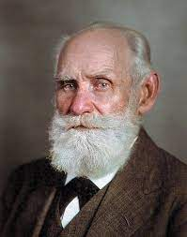
Meet Ivan Pavlov
Who Was Ivan Pavlov?
Russian physiologist
Originally studied digestion in dogs
Won the Nobel Prize in 1904
The Unexpected Discovery
Noticed dogs began to salivate before being fed
Even the sound of footsteps or the sight of the lab assistant made them salivate!

Slide 7
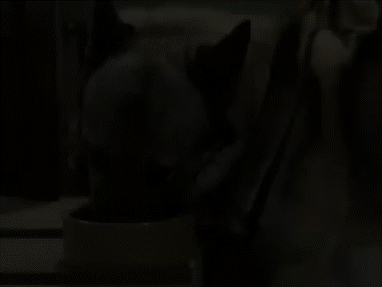
Pavlov’s Experiment – Watch and Learn

Slide 8
Let’s Discuss the Video
What Did You Observe?
What happened when the dog saw the food?
Did the bell make the dog salivate at first?
What changed after the bell was rung several times with the food?

Slide 9
Key Terms in Classical Conditioning
Term | Meaning | Example
UCS (Unconditioned Stimulus) | Something that naturally causes a response | Food
UCR (Unconditioned Response) | A natural, automatic reaction | Salivation to food
NS (Neutral Stimulus) | Something that does not cause a reaction at first | Bell (before learning)
CS (Conditioned Stimulus) | A previously neutral thing that now causes a response | Bell (after learning)
CR (Conditioned Response) | The learned reaction to the CS | Salivation to bell

Slide 10
Pavlov’s Experiment – Overview
Pavlov placed dogs in a controlled environment.
He rang a bell (Neutral Stimulus) before giving them food (Unconditioned Stimulus).
The dogs salivated (Unconditioned Response) when they saw food.
After many repetitions, the dogs began to salivate just at the sound of the bell — even without food!

Slide 11
Step-by-Step Breakdown

Slide 12
Real-Life Applications of Classical Conditioning
School-related Emotions
Habit Formation
Advertising and Marketing
Phobias and Fears

Slide 13
Let’s Practice – Identify the Elements
Scenario Activity:
A child gets bitten by a dog near a red gate. Now, anytime they see a red gate, they cry.
Identify the following:
UCS = ?
UCR = ?
NS = ?
CS = ?
CR = ?
Can you think of your own example from real life?
Dog bite
Crying in pain
Red gate
Red gate (after pairing)
Crying at sight of red gate

Slide 14
Classical vs Operant Conditioning
Feature | Classical Conditioning | Operant Conditioning
Discovered by | Ivan Pavlov | B.F. Skinner
Type of learning | Learning by association | Learning through consequences
Focus | Involuntary behaviours | Voluntary behaviours
Key Mechanism | Pairing of stimuli | Reward and punishment
Example | Bell → Salivation | Studying → Praise or reward

Slide 15
Let’s Test Our Understanding
Decide if the situation shows Classical or Operant Conditioning.
A boy hears the ice cream van’s music and starts to feel excited.→ _____________________
A child gets stung by a wasp while smelling a flower. Later, she avoids flowers.→ _____________________
A girl does her homework and receives praise from the teacher.→ ____________________
A student is allowed to skip class cleaning duties because she arrived early.→ _____________________
Can you give your own example of both types of learning?
Classical Conditioning
Classical Conditioning
Operant Conditioning
Operant Conditioning

Slide 16
Group Discussion – Is It Still Relevant?
Do you think classical conditioning still applies in today’s world?
WHY?

Slide 17
Recap – Key Terms to Remember
Term | Meaning
UCS | Unconditioned Stimulus – something that naturally causes a response (e.g., food)
UCR | Unconditioned Response – the natural reaction (e.g., salivation)
NS | Neutral Stimulus – something that initially causes no reaction (e.g., bell)
CS | Conditioned Stimulus – the NS after learning has occurred (e.g., bell after pairing)
CR | Conditioned Response – the learned reaction (e.g., salivation to bell)

Slide 18
Recap – Pavlov’s Experiment in 3 Simple Steps
Before Conditioning
Food (UCS) → Salivation (UCR)
Bell (NS) → No salivation
During Conditioning
Bell (NS) + Food (UCS) → Salivation (UCR)
After Conditioning
Bell (now CS) → Salivation (now CR)

Slide 19
What Have You Learnt?
Answer these questions in your exercise books:
What is the difference between a UCR and a CR?
What was the neutral stimulus in Pavlov’s experiment?
Explain one real-life example of classical conditioning and mention the NS and the CS.
How is operant conditioning different from classical conditioning?

Slide 20
Homework Assignment
Write a short paragraph explaining an experience you have in relation to classical conditioning.
Identify the
UCS,
UCR,
NS,
CS, and
CR in your experience.

Slide 21
Questions & Reflections
Any Final Questions?
What did you find most interesting about today’s lesson?
Do you now notice how you’ve been classically conditioned in your own life?

Slide 22

Thank you for your ATTENTION and PARTICIPATION!

